Slide 1
Are interactions real?
Yizhou Liu
Dec 06, 2023

Slide 2
Outline
Interactions between “free” fermions – DPP & its sampling – GUE
Bosons and PerPP – Boson sampling
Interactions from statistics & transformations/symmetry (how universal?)
More examples? Random fields (polynomials, processes)
Looking for the kernel (not successful but find some patterns)

Slide 3
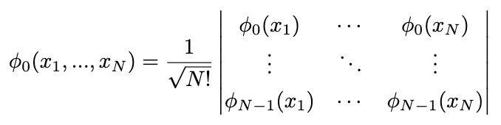
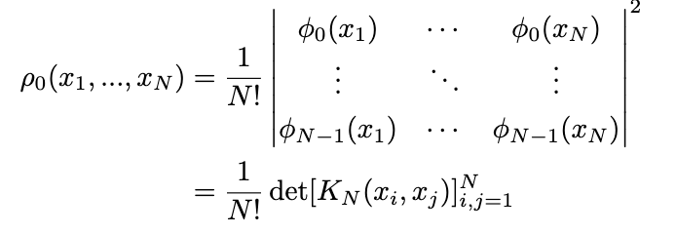


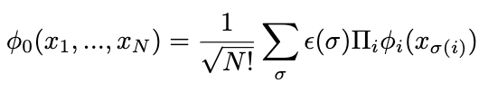






Free fermions are repulsive
Free but correlated
Indistinguishable
No interaction in Hamiltonian
$$φ_{N−1}$$
…
$$φ_{2}$$
$$φ_{1}$$
$$e^{iφ}$$
$$φ_{0}$$
?
First number them, but then eliminate numbering:
Vandermonde+quadratic

Slide 4
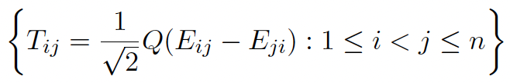

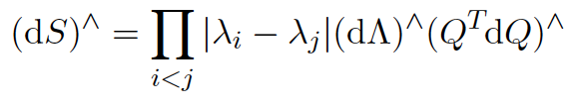
Why are GUE eigenvalues fermions at ground states
Same distribution after writing down but why
Fermions: antisymmetric subspace of Hilbert space -> det
GUE or GOE:
Rotation: projection to the tangent space
antisymmetric subspace: repulsion
Gaussian: quadratic potential
Anti symmetricity
Free particles with symmetry leads to
correlation in other representations
Why ground state?
Self energy?
Two dimensional electrons?

Slide 5






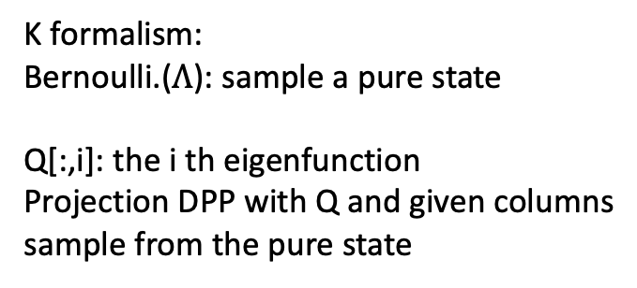
DPP sampling – measuring mixed states of fermions
Mixed state vs. pure state
Average probability or wave function superposition
K formalism:
Bernoulli.($Λ$): sample a pure state
Q[:,i]: the i th eigenfunction
Projection DPP with Q and given columns
sample from the pure state
$$φ_{N−1}$$
…
$$φ_{2}$$
$$φ_{1}$$
$$λ_{1}$$
$$φ_{0}$$
$$λ_{0}$$
Expected number of fermions at this energy level

Slide 6






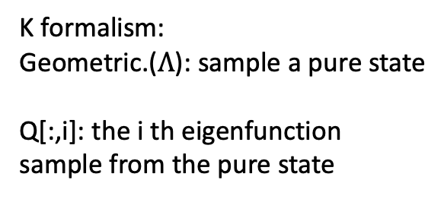
PerPP for Bosons
symmetric subspace: positive correlations in space or time (attraction?)
K formalism:
Geometric.($Λ$): sample a pure state
Q[:,i]: the i th eigenfunction
sample from the pure state
$$φ_{N−1}$$
…
$$φ_{2}$$
$$φ_{1}$$
$$λ_{1}$$
Can have the same $φ_{i}$ showing up multiple times
$$φ_{0}$$
$$λ_{0}$$
Expected number of Bosons at this energy level
Boson sampling
“able to output a sample for n = 30 bosons in half an hour on a standard laptop”
Have not found efficient algorithm?
Neville, A., Sparrow, C., Clifford, R. et al. Classical boson sampling algorithms with superior performance to near-term experiments. Nature Phys 13, 1153–1157 (2017)

Slide 7
Questions
How universal are “interactions” from statistics & transformations/symmetry?
Try roots of polynomials (not physical systems but at least see if fermions and bosons work)
Polynomials \in DPP & PerPP
DPP & PerPP \in Polynomials?

Slide 8

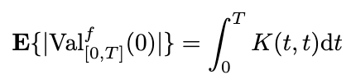
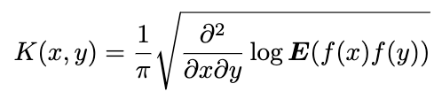






Number of zeros provides some intuitions
Polynomials \in DPP & PerPP? Try to find the kernel
Kac-Rice formula, change variable from $δ\left(X\right)dX$ to $δ\left(X\left(t\right)\right)X^{′}dt$
Consider random polynomials (or sum of other functions) with zero mean Gaussian coefficients
K formalism:
Eigenvectors: eigenstates (different energy levels)
Eigenvalues:
$$φ_{N−1}$$
…
$$φ_{2}$$
$$φ_{1}$$
$$λ_{1}$$
For DPP and PerPP,
trK formula ☺
Expected numbers of particles at energy levels
$$φ_{0}$$
$$λ_{0}$$

Slide 9
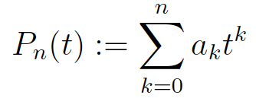
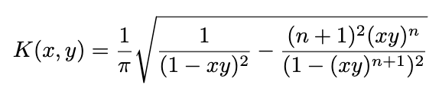
Kac polynomials
Solving from polynomials
DPP from
However, not bad if we don’t do projDPP
after selecting the pure state
System mainly determined by the eigenstates
Tested n = 100, 200, 300

Slide 10
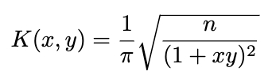

KSS polynomials
$$σ_{k}^{2}=\left({n \atop k}\right)$$
Solving from polynomials
Sample points based on eigenvalues and eigenstates
Tested n = 100
negative
positive

Slide 11
Use random poly to reconstruct DPP?
DPP & PerPP \in Polynomials
#Zeros
trK
Eigenstates with most particles

Slide 12
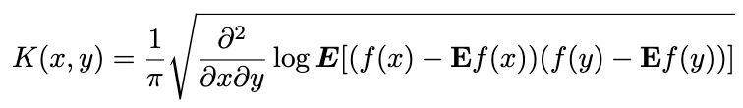
Use random poly to reconstruct DPP?
DPP & PerPP \in Polynomials
Intersection with its mean?

Slide 13
Transformation (symmetry) + randomness
General for real system?
Modeled by simple mixture of DPP & PerPP?
Elements to eigenvalues
Coefficients to zeros
Elements
Coefficients
X
Interactions: intrinsic repulsion or attraction + potential field
Start with random functions
Only work for special polynomials
Can be refined to consider…
In general not working, but still recover some patterns in eigenstates

